Slide 1
Project Guide:
Dr. Preeti Chandrakar
( Assistant Professor)
Implemented By:
K . Raj Kamal – 16115030
G . Jayanth – 16115022
K. Gautham - 16115029
Accident Prediction with Severity Level Exploration

Slide 2
Problem Definition
Road traffic issues moreover has become the backbone for major injuries, death in recent times. The problem is negligence and false approach towards the better analysis of traffic events
Although road traffic injuries have been leading cause of mortality for many years most traffic crashes are both predictable and preventable.
There is a considerable evidence on interventions that are effective at making road safer, countries that have successfully implemented these interventions have seen corresponding reductions in road traffic deaths.
Our goal is to design a model which gathers the environmental conditions, Physical attributes and predict the possibility of occurrence of accidents, and if there is a chance it explores the severity level of accident and to design a GUI through which even a normal user can interact with trained model..

Slide 3
Introduction & Literature survey
Reducing traffic accidents is an important public safety challenge, therefore, accident analysis and prediction has been a topic of much research over the past few decades. Using small-scale datasets with limited coverage, being dependent on extensive set of data, and being not applicable for real-time purposes are the important shortcomings of the existing studies.
To address these challenges, we use a new dataset labeled as “US Accidents” published in the paper titled “Accident Risk Prediction based on Heterogeneous Sparse Data: New Dataset and Insights”. This dataset with 3 million records can be used as a solution for real-time traffic accident prediction using easy-to-obtain, but sparse data. Using this dataset accompanied with Machine Learning and Deep Learning models we want to design better solutions than the ones presented in the base reference paper.
In paper titled “Accident Risk Prediction based on Heterogeneous Sparse Data: New Dataset and Insights” they proposed this dataset and designed the Deep Accident Prediction model based on artificial neural networks. For the initial analysis we considered the paper titled “A Countrywide Traffic Accident Dataset” through which the initial version of the dataset was published.

Slide 4
Scope and Objectives
Traffic accidents reduce level of traffic safety and cause traffic congestions. In order to increase the level of traffic safety, it is necessary to ensure that the causes of accidents are revealed and the risks are minimized.
Objectives are :
Based on the climatic conditions and the physical input features predict the probability of occurrence of an accident.
Once there’s a possibility of an accident then we further explore the severity level associated with that accident.
To design a Graphical User Interface which allows end user interact with trained model.

Slide 5
Architecture and Flow Control

Slide 6
Cont..
The diagram also explains the flow of data and what transformations it undergoes during each phases.
The actual dataset used consists of 3 Millions records. This dataset is imbalanced due to inconsistency in number of records belonging every class. So we made various versions of datasets to make it balanced and applied suitable machine learning models to better predict the target variable.
The overall Architecture of the project shown below shows the Data Preprocessing, EDA (Exploratory data analysis) and Modeling phases in detail.

Slide 7
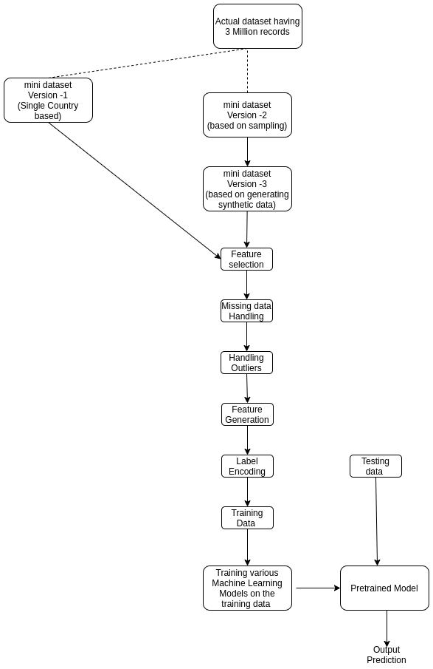

Slide 8
Versions of datasets :
The actual dataset used consists of 3 Millions records. This dataset is imbalanced due to inconsistency in number of records belonging every class. So we made various versions of datasets to make it balanced and applied suitable machine learning models to better predict the target variable.
Version - 0 : Actual Dataset
Version - 1 : Dataset Considering single country info
Version - 2 : Sampling Version 0 Dataset
Version - 3 : Generating Synthetic data for minority classes of Version -2

Slide 9
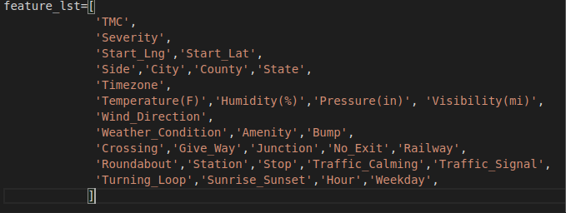
Feature Selection
The features that are relevant for the task of accident prediction are only selected and the rest of the features have been removed from the dataset. A total of 31 features(29 available from the actual dataset and 2 additional features generated through the feature generation step explained in the below section) are being selected from the available 49 features.
The features such as End_Lat (ending latitude of the accident), End_Lng (Ending Longitude of the accident) can be removed since they do no effect target variable.

Slide 10
Null Value Handling
A value in the dataset may go missing for several reasons and dealing with this value is very important because it might some useful insights to the model and increases the dependability of the model.
Ways for handling Null values :
- Numeric Data - drop records - consider as a separate class - impute with mean/median/mode - impute with class wise mean/median/mode - fit to a regression line and predict the missing value - perform clustering and take the sample nearest to missing value sample (or) take the cluster center - Categorical Data - drop records - replace with most common - replace with most common among the class - perform classification and predict the missing class (only if we are having around 5-10 classes) - perform clustering and take the sample nearest to missing value sample (or) take the cluster center

Slide 11
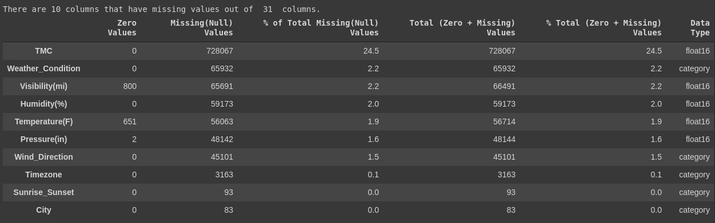
List of columns with number of null values for respective column

Slide 12
Outlier Handling
An outlier is a data point that differs significantly from other observations.
Handling such a datapoint is necessary just too make sure it won’t deviate the ML/DL model to the extreme conditions and focusing less on general data. The outlier data may be both Numeric and categorical :
- Numeric Data - drop - replace with min/max - Categorical Data - consider minority classes as a single class - remove minority class

Slide 13
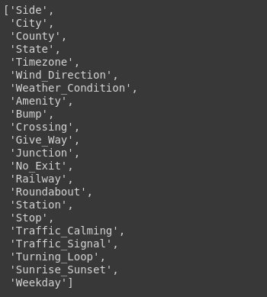
Categorical Variable Encoding
A categorical variable is a variable that can take on one of a limited, and usually fixed, number of possible values.
But in order to pass the value of that categorical variable we have to encode it into a numeric value.
Ways to encode :
Categorical Encoding – assigning each class a number
One Hot encoding
The snapshot mentioned has the list of variables with categorical data.

Slide 14
Scaling and Normalization
Scaling and normalization is important because to increase the interpretability of the data.
Scaling the numeric features means applying some linear transformation and bringing them to common range.
Various ways for scaling:
Standardization
Normalization
Z – score transformation

Slide 15
Splitting Dataset :
Now once all the data transformation steps are completed we have to split the entire dataset into training, testing and validation sets. Now this splitting is necessary because in order to evaluate the performance of the model, we have to make the model to predict on unseen data during the training phase.
Now consider the entire dataset before the split as 100%, then we divided 60% for training, 20% for testing and 20% for validation. After the splitting is done, the machine learning models are trained on the training data, validated on the validation data and finally tested on the testing data.

Slide 16
Models Used :
Once the dataset is ready then after peforming pre-processing of data we applied various machine learning models. They are
Logistic Regression
K-Nearest Neighbors
SVM
Random Forest Classification
Naïve Bayes Classification
Boosting algorithms like XGBoost and CatBoost.
Voting Classifier

Slide 17
Results and Performance Evaluation

Slide 18
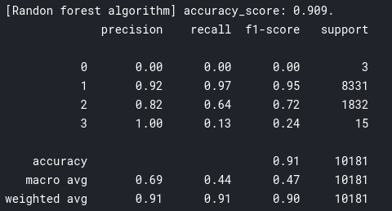
Results on version 1 of dataset
From among all the above shown models, the Random Forest Classifier is performing the best with 90.9% testing accuracy. But the problem with this version of the dataset is, even though the overall accuracy of the model is good enough, but the model is performing very poorly on the class having Severity Level 1, since it merely has 900 samples overall.

Slide 19
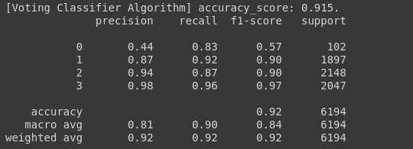
Results on version 2 of dataset
From among all the above used models the Voting classifier, which is a combination of the Random Forest and XGBoost classifier is performing the best with 91.5% testing accuracy. And we can also observe that the precision recall and to say, the overall performance on the minority classes is increased very well when compared to the previous versions

Slide 20
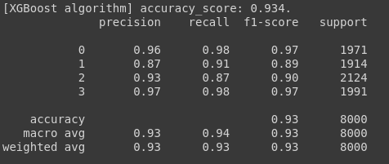
Results on version 3 of dataset
From among all the models XGBoost classifier was performing the best with 93.4% testing accuracy. Apart from improving the overall accuracy, the class wise performance of the models has also been improved, now the models are performing equally well on all the classes.So this version of dataset stands out to be best version

Slide 21
Graphical User Interface
We not only deleloped a model, also designed a interface which allows end user to predict the accident occurrence.
we should be able to be able to take the input from the user and run the pre-trained machine Learning models on that given input and then finally display the generated output(or to say prediction) to the user.

Slide 22
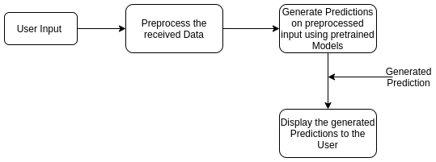
Cont..
Once the preprocessing of the retrieved data is completed then a pre-trained model is used and this preprocessed data is given as input. The pre-trained model takes the input and generates the output prediction. This prediction is passed on to the Frontend and displayed to the user through a nice design, designed with HTML, CSS and Bootstrap.

Slide 23
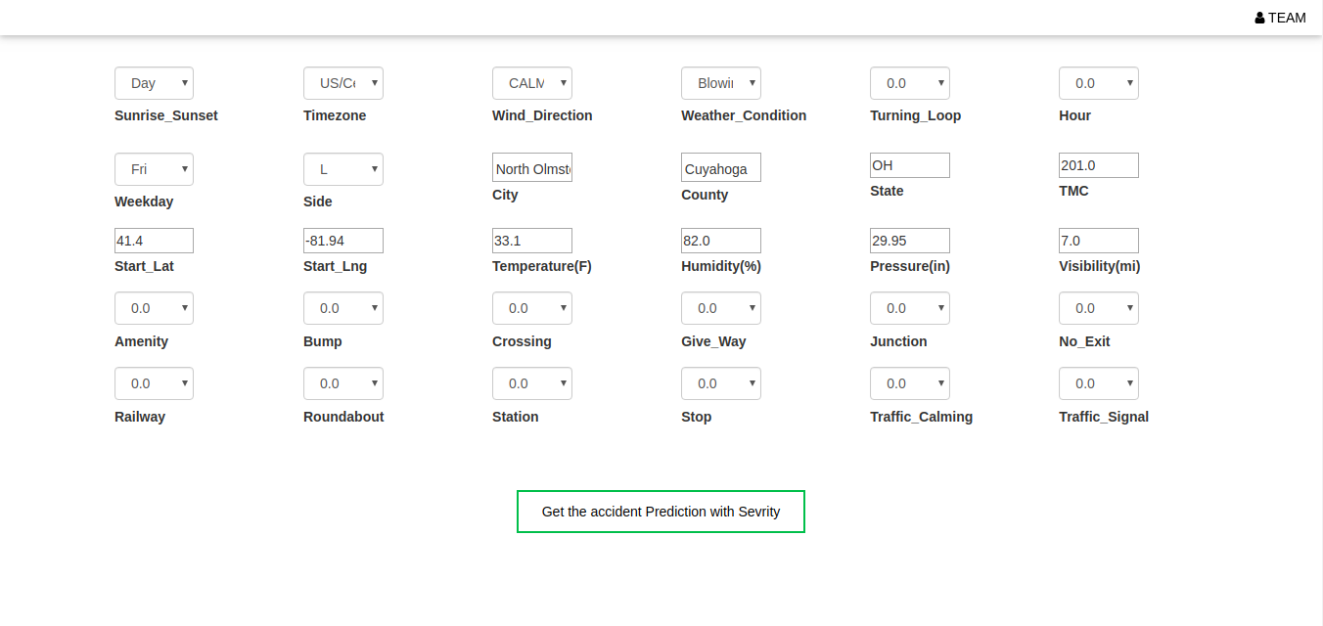
Veiw of Designed web page

Slide 24
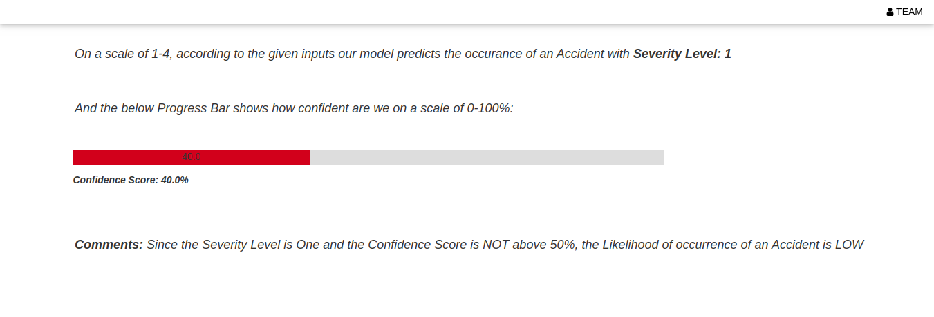
Output display page

Slide 25
Future Scope
The future scope of this project includes finding out the most effective ways of generating synthetic data in large amounts without deviating from the distribution of the actual data. Due to the short time constraint we weren’t able to employ complex deep learning models, so employing various deep learning models would be a great concept to explore if we can be able to generate more meaningful synthetic data in large numbers.
By employing more complex deep learning models we can design much more reliable prediction models. In this project we’ve designed a web page to interact with the model, we can actually build an App and also design an API for the same. Through that API whenever there is high probability for the occurrence of an accident then an alert message can be sent to the nearest traffic police along with vehicle number.

Slide 26
Technologies Used
Languages used : Python
Libraries used : Numpy, Pandas, Matplotlib, Seaborn, Pickle, Sklearn.
Technologies Used : Google Colab, Kaggle, Flask, html ,CSS, Bootstrap.

Slide 27
References
Moosavi, S., Samavatian, M. H., Parthasarathy, S., & Ramnath, R. (2019). A Countrywide Traffic Accident Dataset. arXiv preprint arXiv:1906.05409.
Moosavi, S., Samavatian, M. H., Parthasarathy, S., Teodorescu, R., & Ramnath, R. (2019, November). Accident Risk Prediction based on Heterogeneous Sparse Data: New Dataset and Insights. In Proceedings of the 27th ACM SIGSPATIAL International Conference on Advances in Geographic Information Systems (pp. 33-42).

Slide 28
Thank You
Project Guide: Submitted By:
Dr. Preeti Chandrakar K . Raj Kamal - 16115030
( Assistant Professor) G . Jayanth Kumar – 16115022
K . Gautham Kumar -16115029

